Slide 1
Report 11/27/2020
P. Hacker

Slide 2
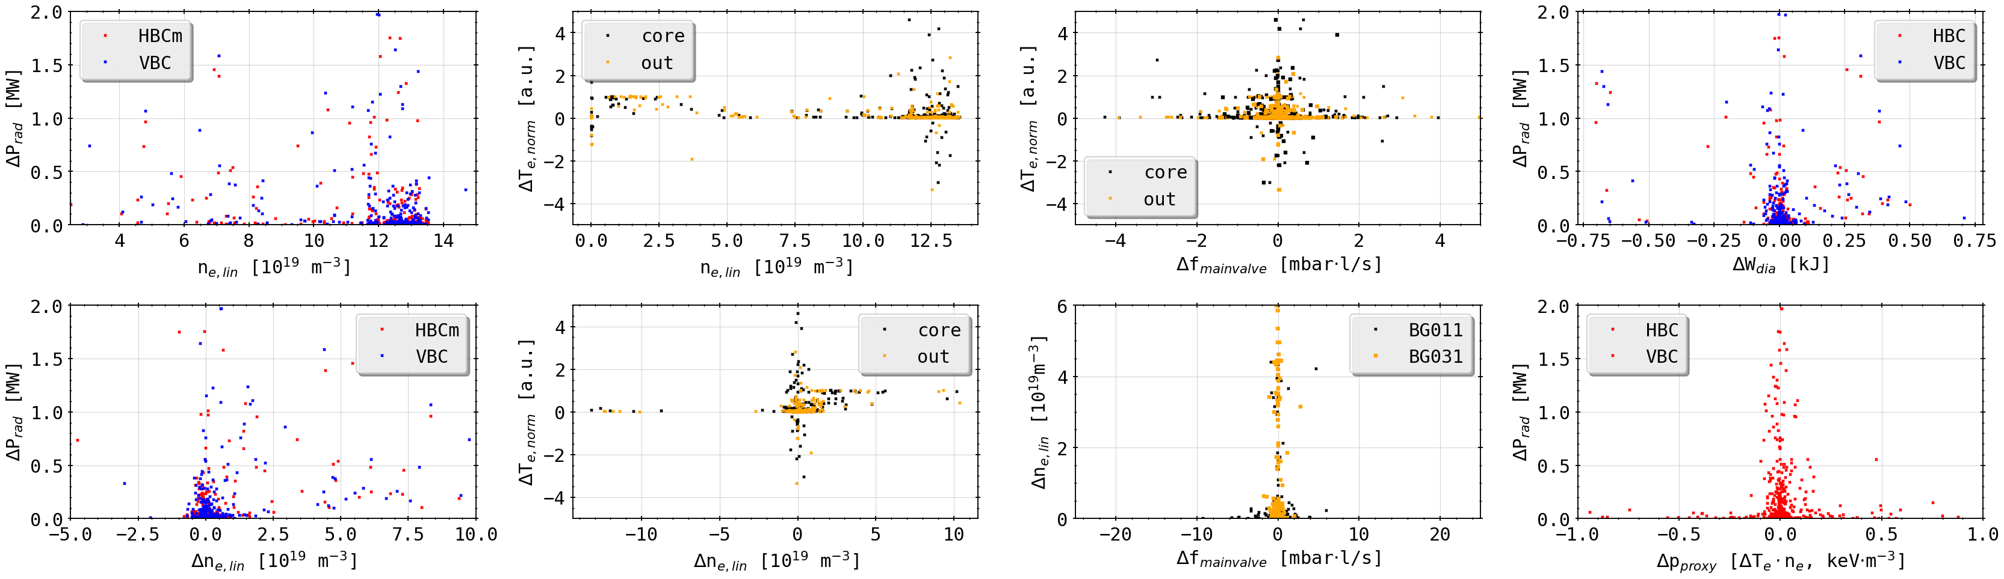
Peak Database: Plasma Parameters
looking up general plasma parameters, where possible, at points in time of peak detection from previous database display
pre-filtered misleading results: spiking, digital glitching or missing data
no obvious grouping of radiation increase over plasma density
slightly higher radiation increase potential for higher plasma densities
assuming at given density, larger range of radiation increase possible

Slide 3
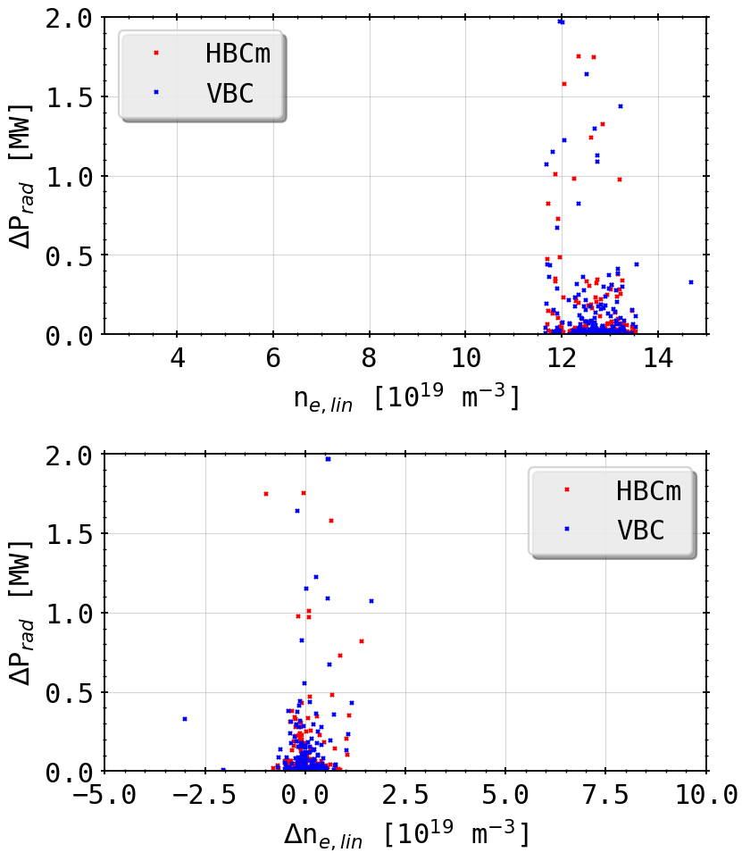
Peak Database: Plasma Parameters
only f_rad > 0.5

Slide 4
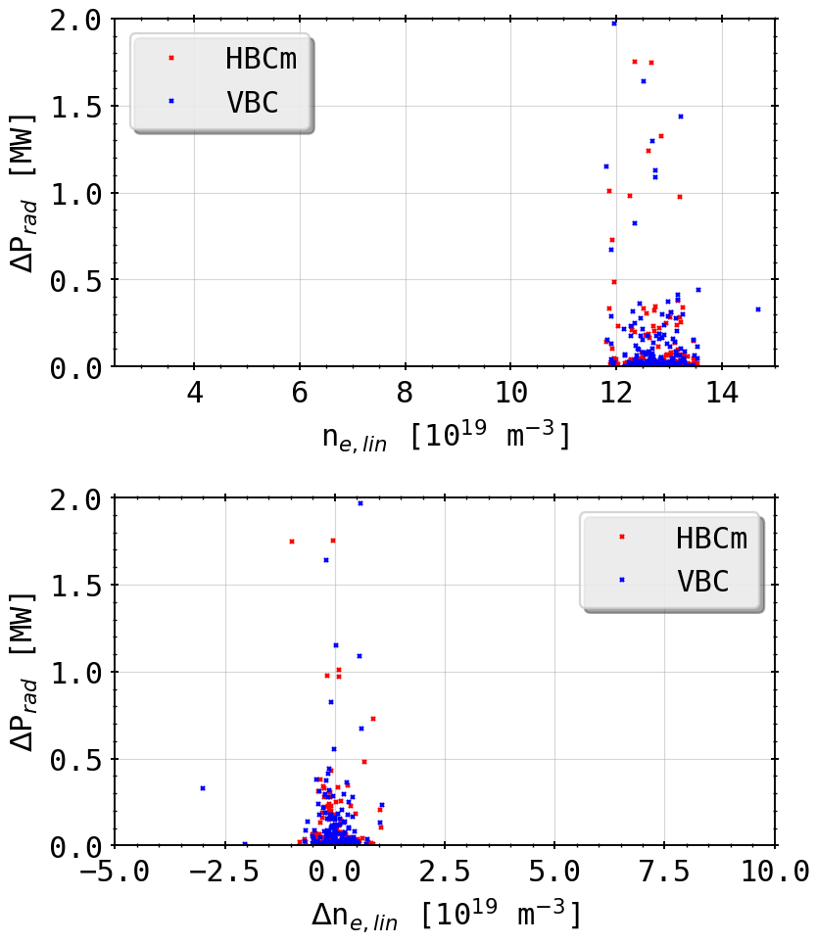
Peak Database: Plasma Parameters
only f_rad > 0.9

Slide 5
Peak Database: Plasma Parameters
increase/decrease in plasma temperature over plasma density
similarly no grouping of parameters obvious

Slide 6
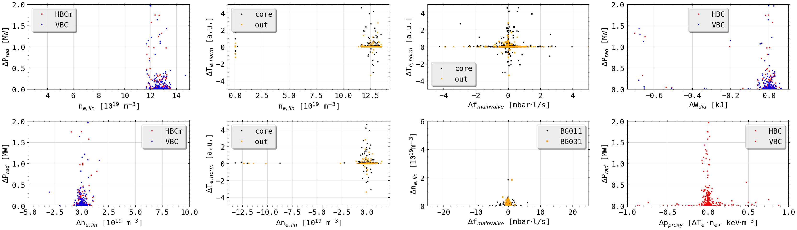
Peak Database: Plasma Parameters
only f_rad > 0.75

Slide 7
Peak Database: Plasma Parameters
change of density and temperature in relation to change in gas flow from main gas valves (any gas)

Slide 8
Peak Database: Plasma Parameters
only f_rad > 0.75

Slide 9
Peak Database: Plasma Parameters
change of radiation power loss in relation to plasma stored energy and pressure proxy by product of temperature and densit

Slide 10
Peak Database: Plasma Parameters
only f_rad > 0.75

Slide 11
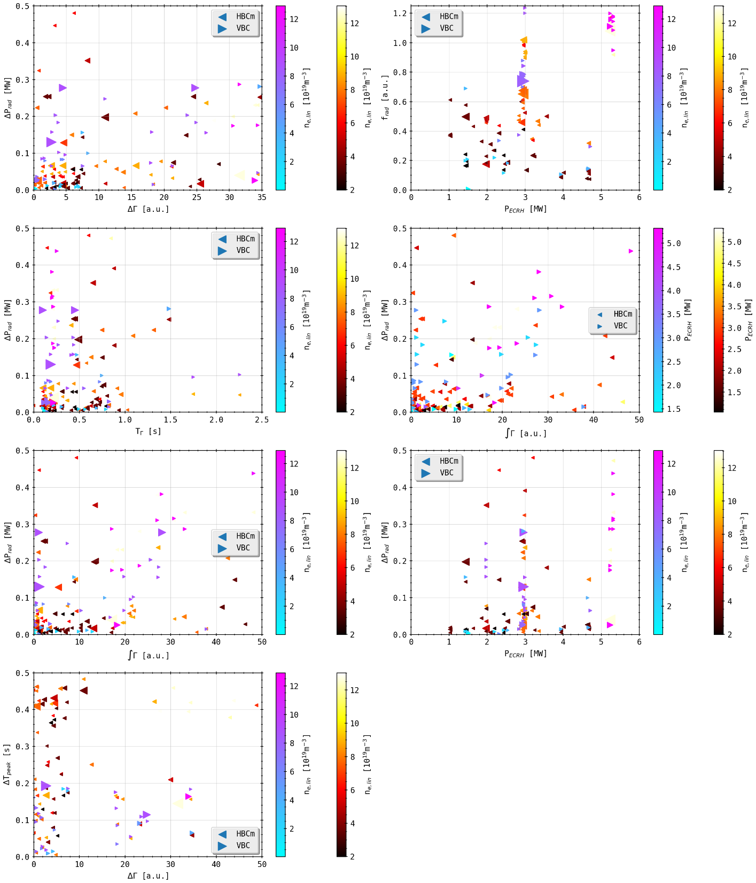
Peak Database: Plasma Parameters
(H2, 100ms)

Slide 12
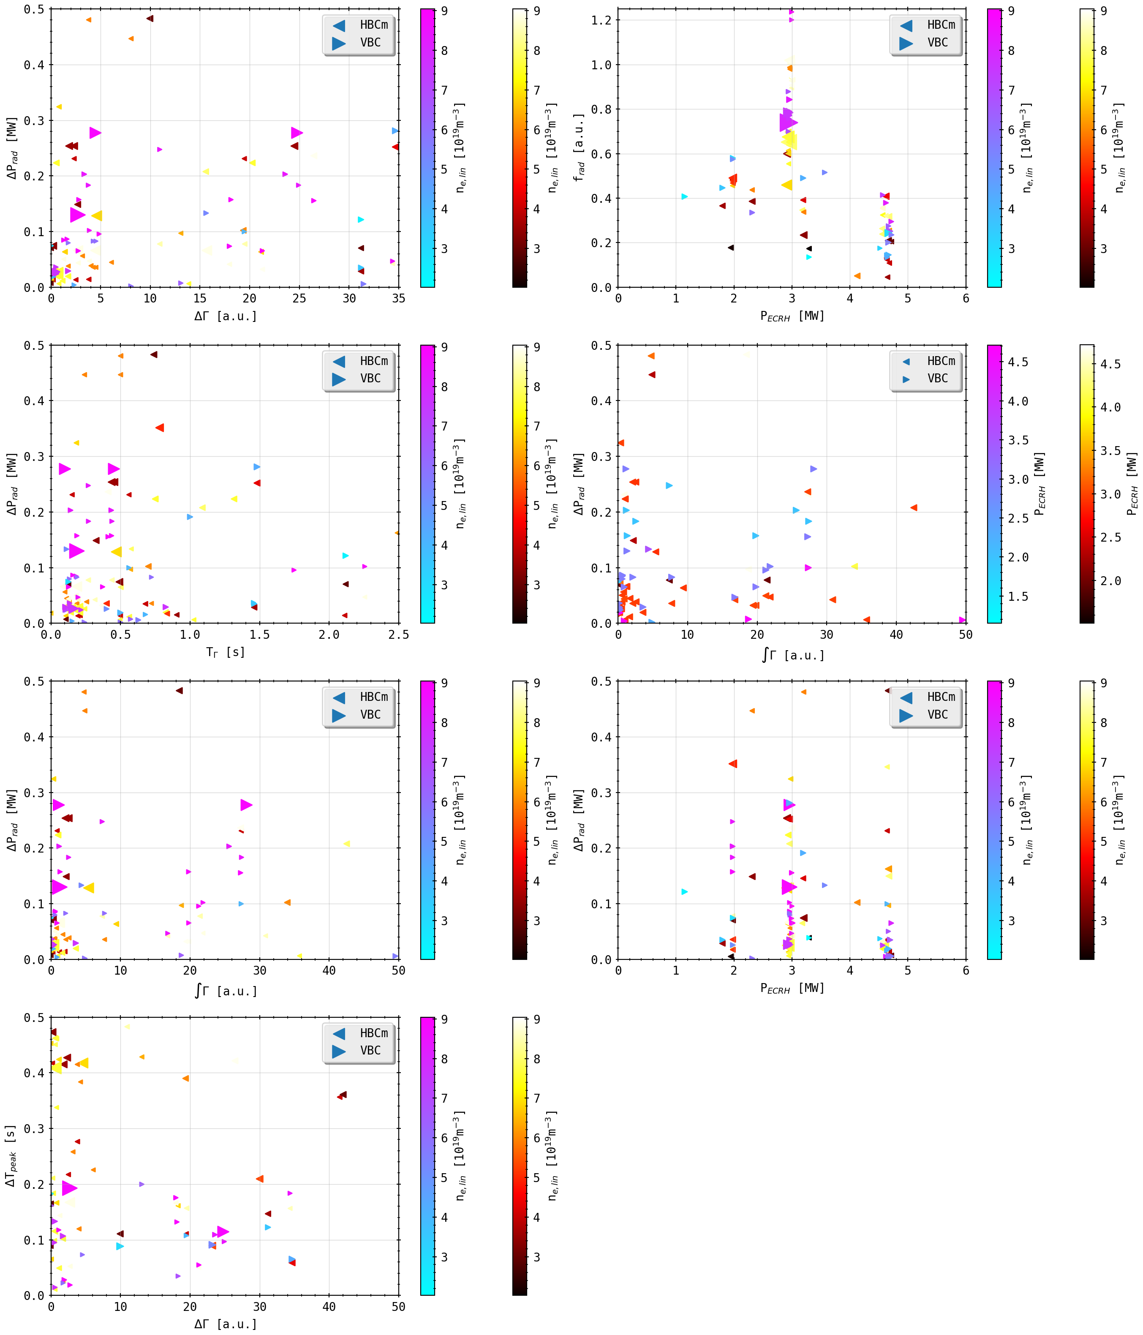
Peak Database: Plasma Parameters
(He, 100ms)

Slide 13
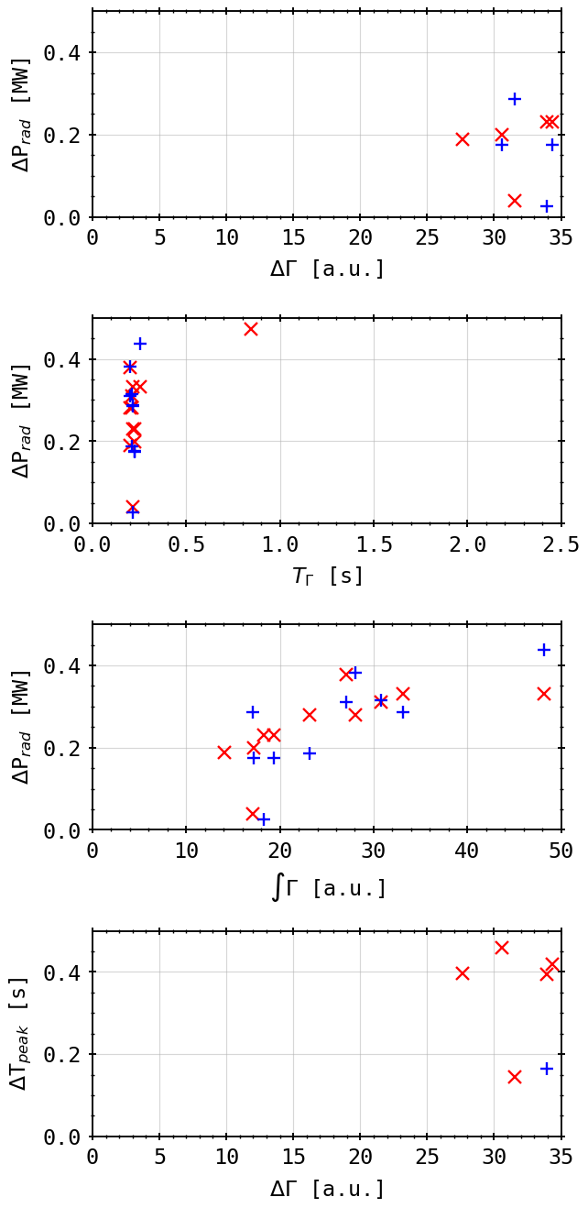
Peak Database: Plasma Parameters
results only shown for the feedback controlled discharge XPID 20181010.032
used feed-forward and density control on the main gas valves and the thermal gas valve for radiation loss feedback (H2)
‘fix’ temporal reaction delay of 200ms
linear correlation between puff and radiation reaction:

Slide 14
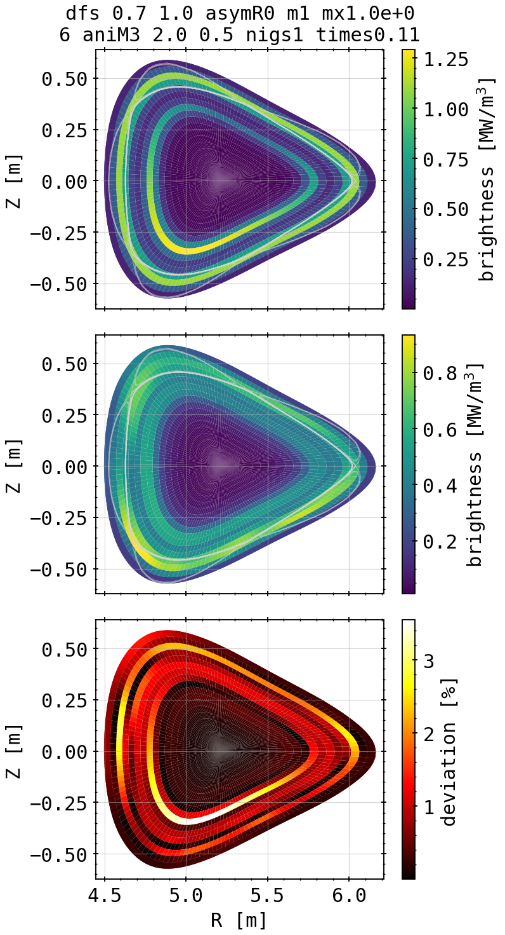
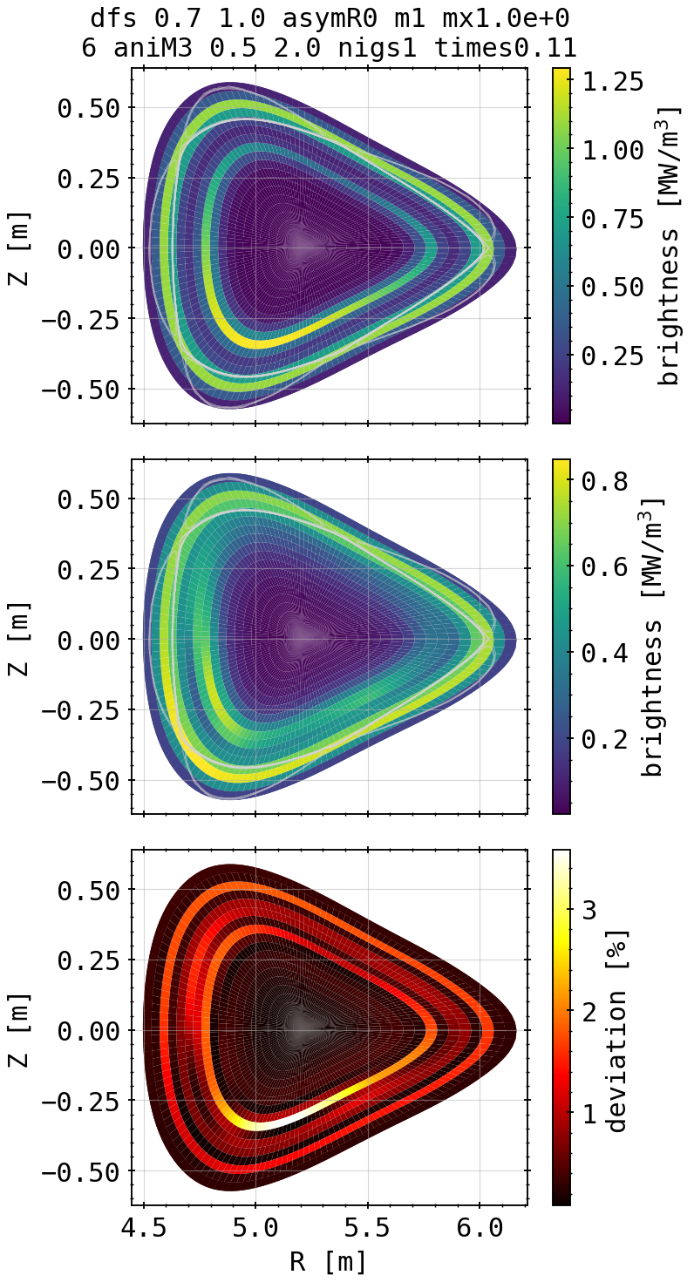
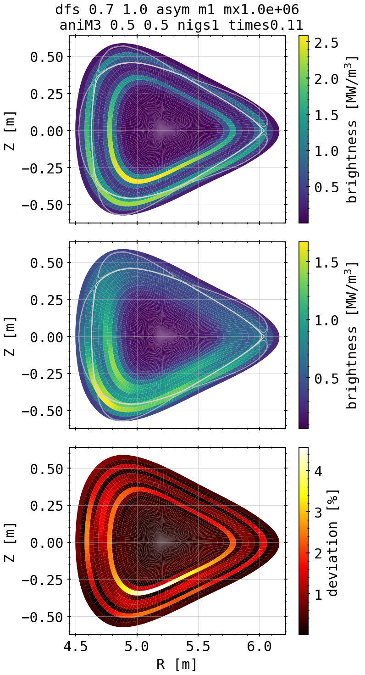
Asymmetry Propagation: Phantoms
inside asymmetry, assuming symmetry
inside asymmetry, assuming asymmetry
outside & inside asymmetry,
assuming asymmetry

Slide 15
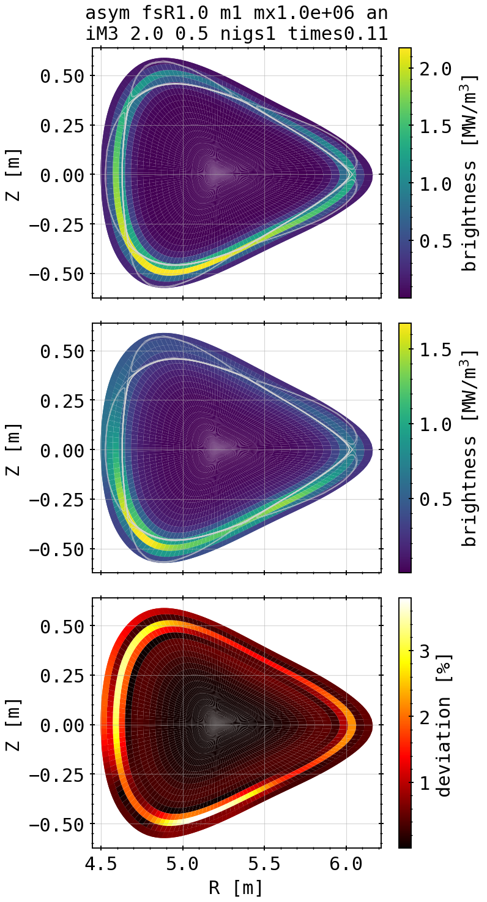
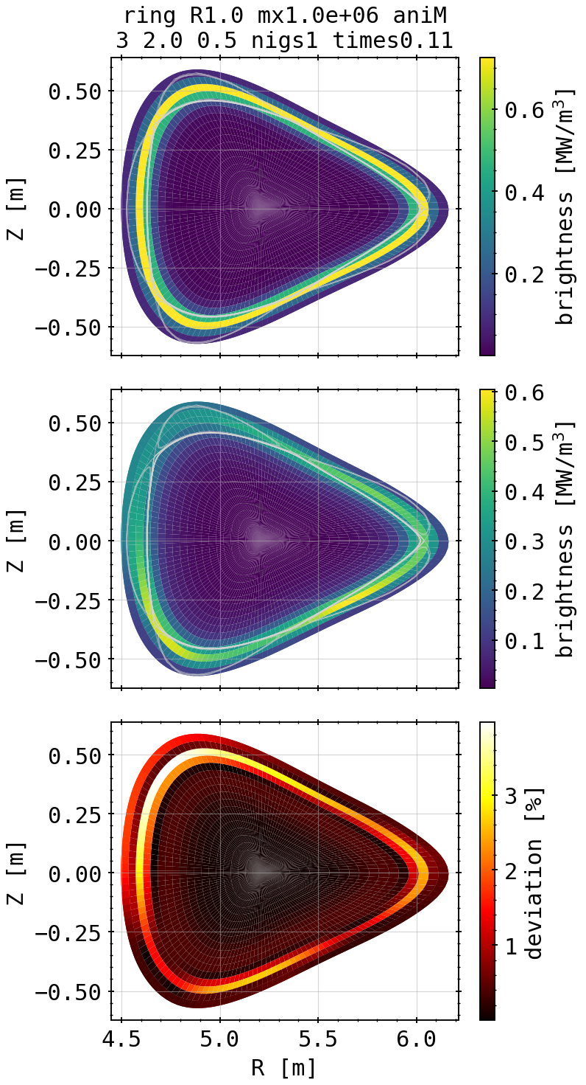
Asymmetry Propagation: Phantoms
outside asymmetry, assuming asymmetry
outside symmetry, assuming asymmetry

Slide 16
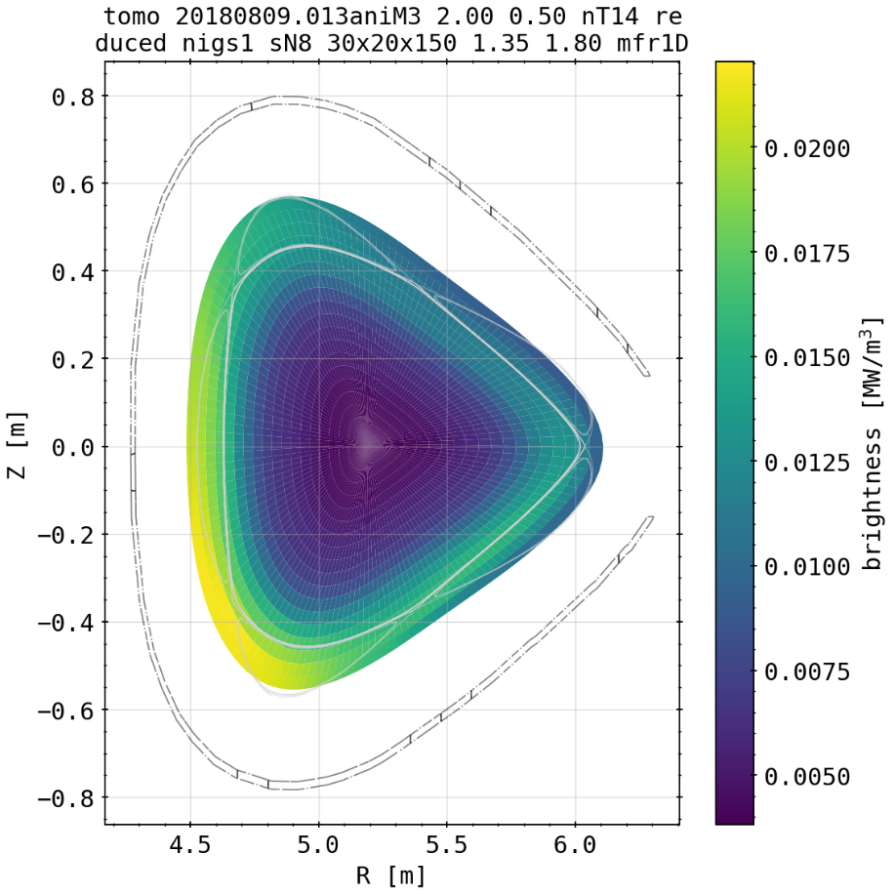
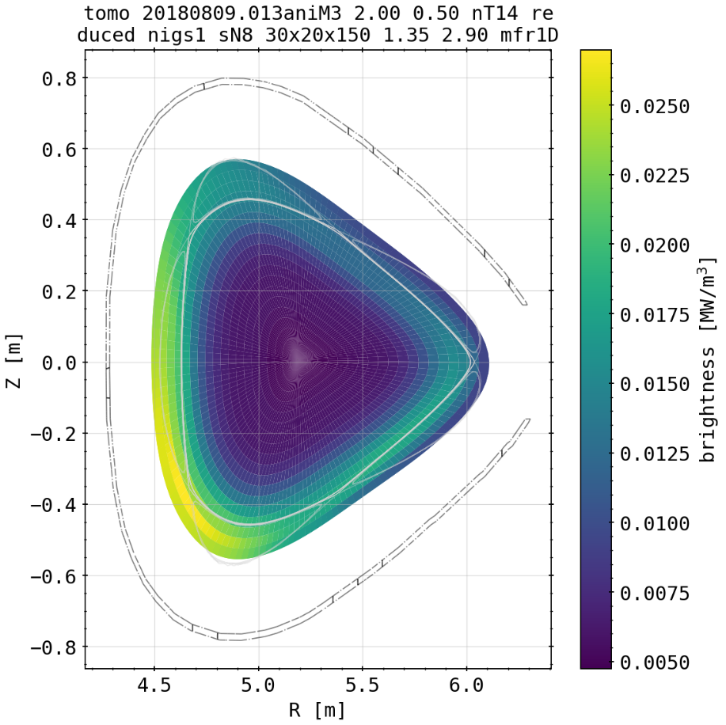
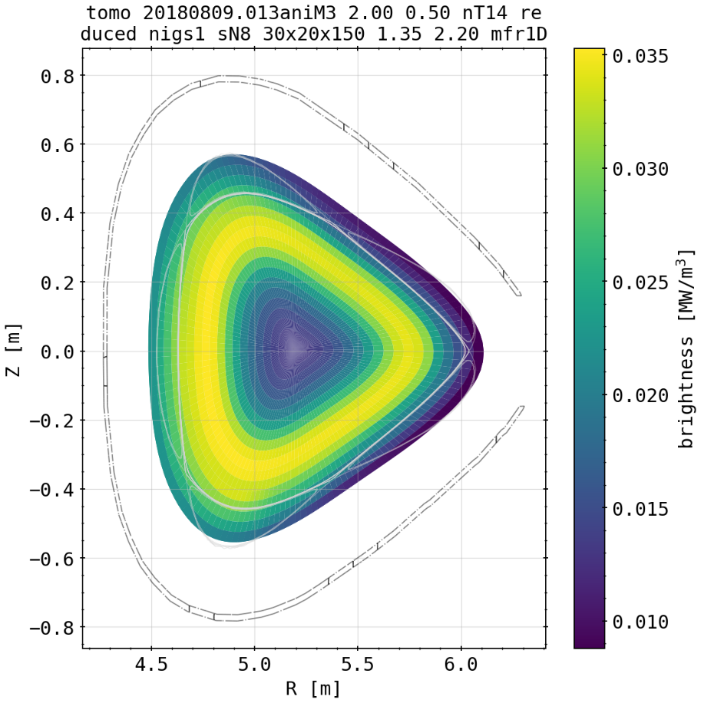
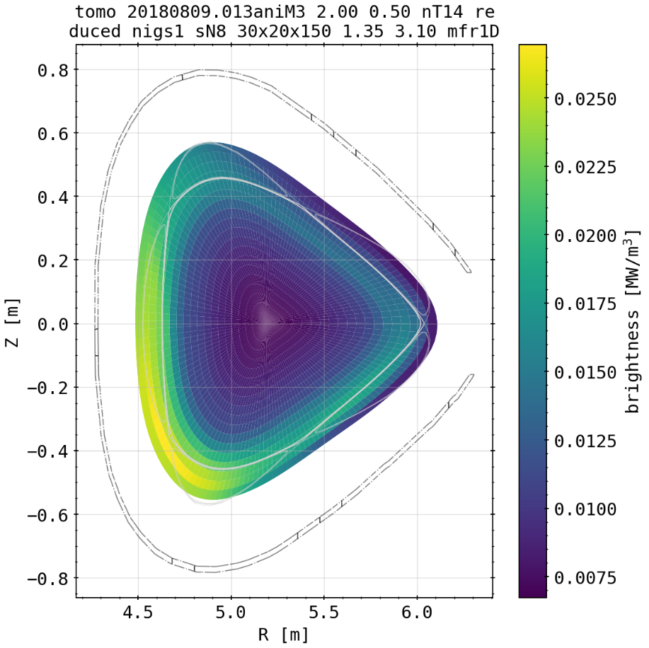
Asymmetry Propagation: 20180809.013
(core symmetric, SOL asymmetric)

Slide 17


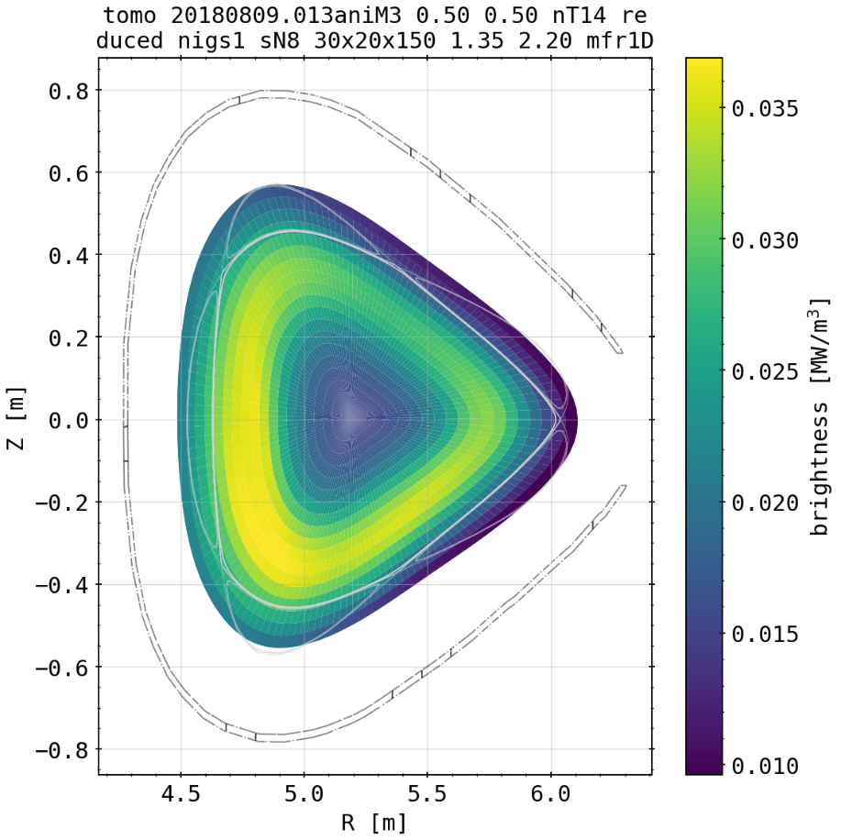
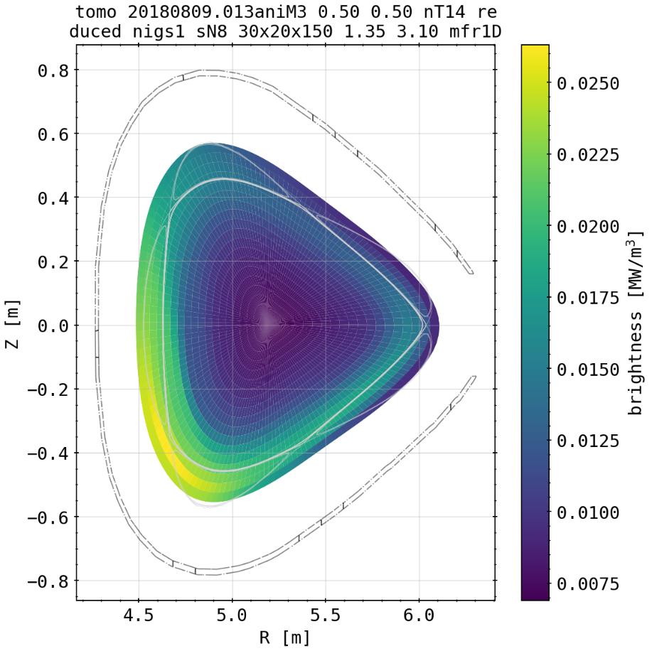
Asymmetry Propagation: 20180809.013
(core symmetric, SOL asymmetric)

Slide 18
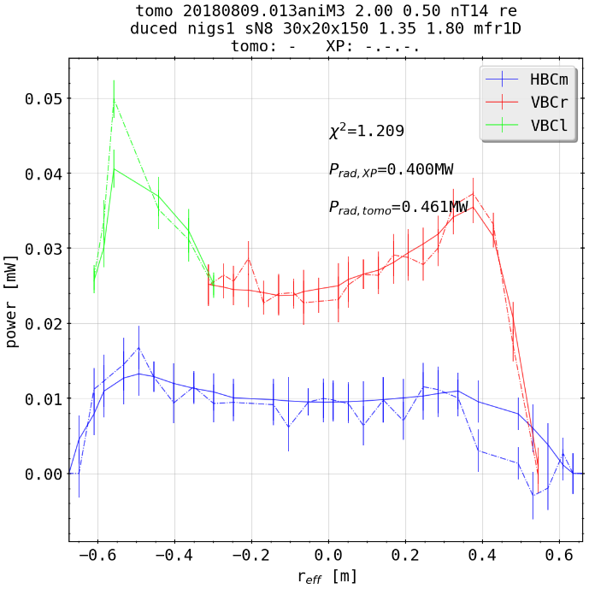
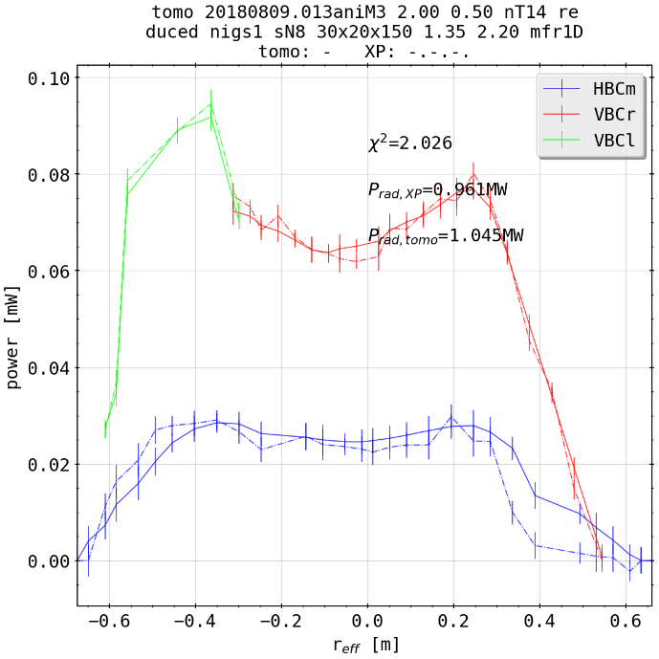
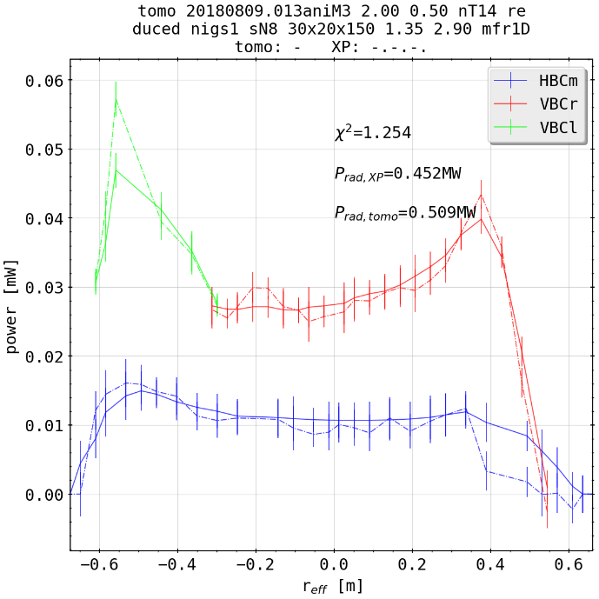
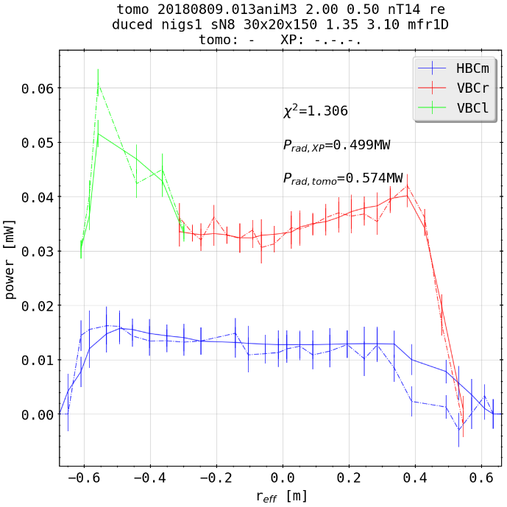
Asymmetry Propagation: 20180809.013
(core symmetric, SOL asymmetric)

Slide 19



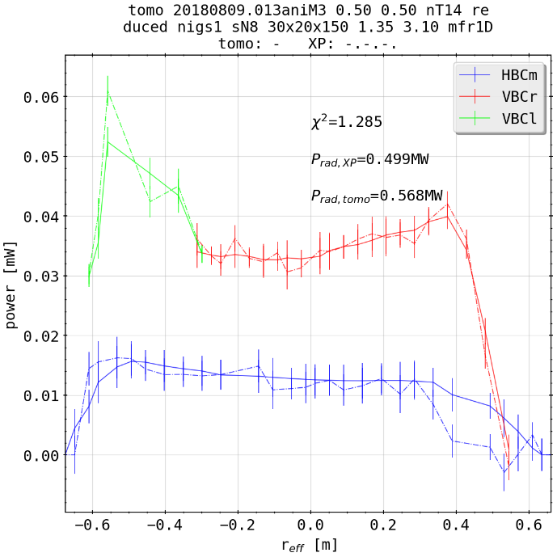
Asymmetry Propagation: 20180809.013
(core asymmetric, SOL asymmetric)

Slide 20
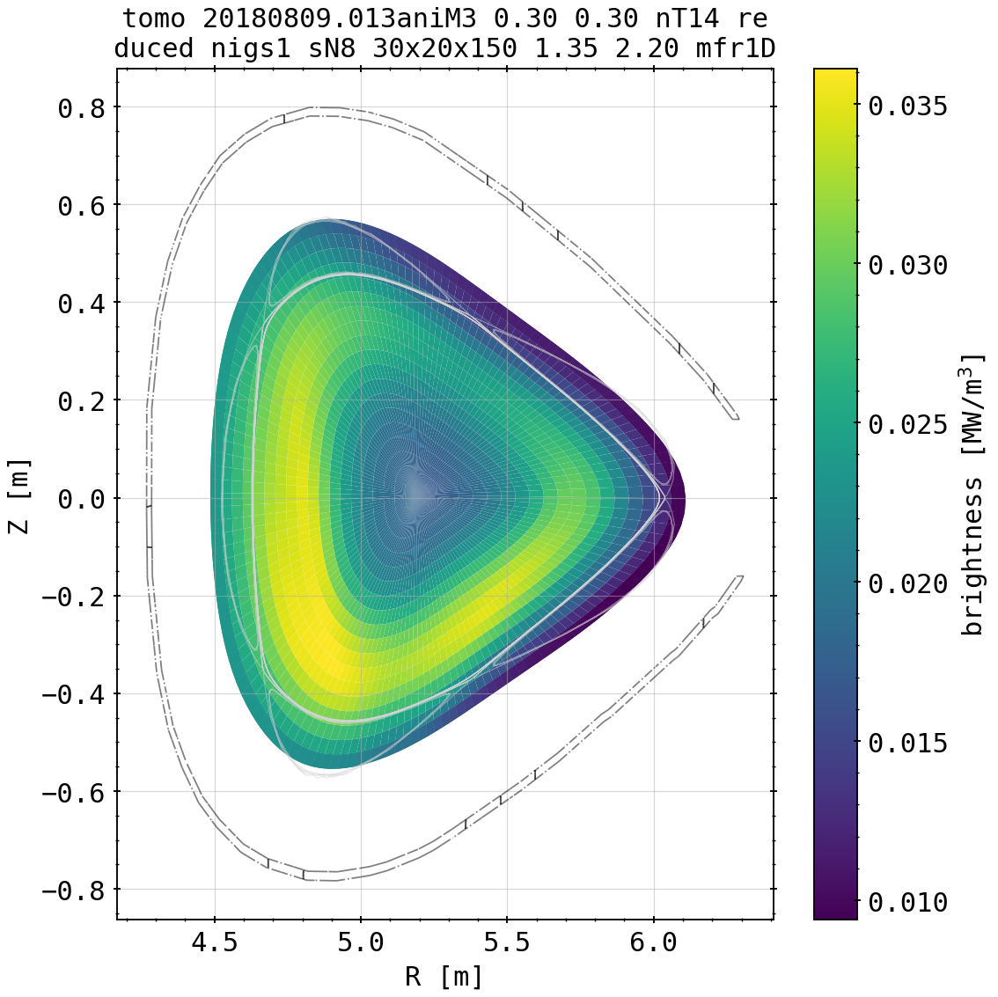

Asymmetry Propagation: 20180809.013
(core asymmetric, SOL asymmetric)

